Slide 1
Minimal Cover
(最小覆盖)
(最小函数依赖集)

Slide 2
Algorithm: Minimal Cover
Algorithm Minimal Cover (最小覆盖)
  a minimal set M of FDs that covers a given set F of FDs.
  step 1: From the set F of FDs, we create an equivalent set H of FDs, with only single attributes on the right side.

Slide 3
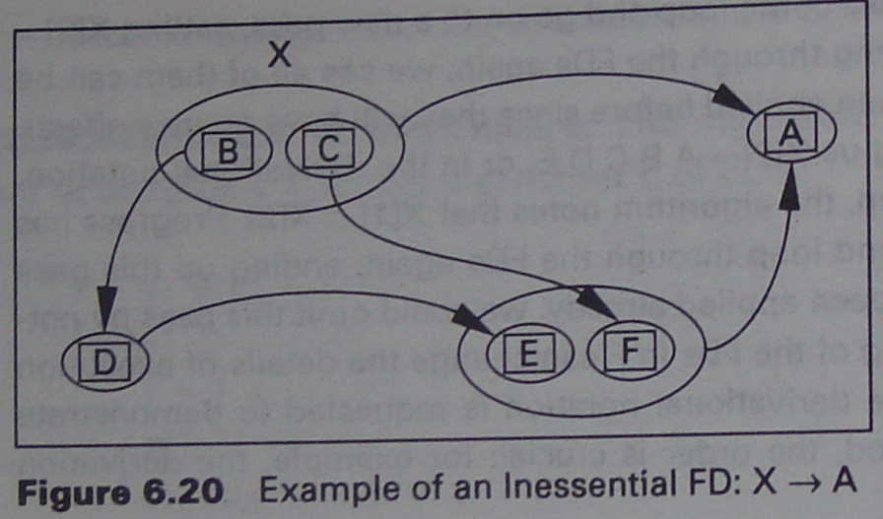
Algorithm: Minimal Cover
  step 2: From the set H of FDs, successively remove individual FDs that are inessential in H.
    An FD X→Y is inessential in a set H of FDs, if X→Y can be removed from H, with result J, so that H⁺=J⁺, or H=J.
    That is, removal of the FD from H has no effect on H⁺.

Slide 4
Let:
  F = {B→D, D→E, C→F, BC→A, EF→A}
  H = F – {BC→A} = {B→D, D→E, C→F, EF→A}
BC→A is inessential in F because of F⁺=H⁺

Slide 5
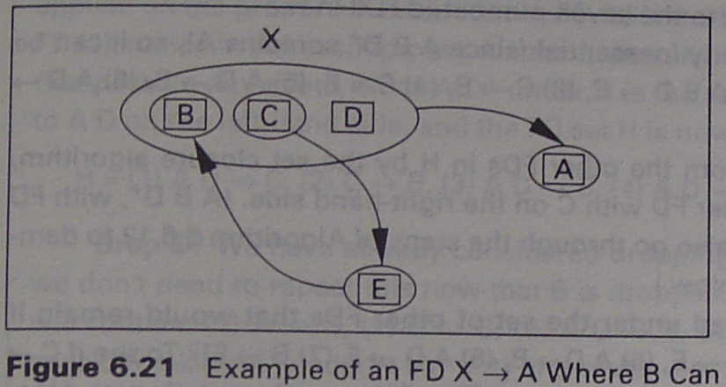
Algorithm: Minimal Cover
step 3: From the set H of FDs, successively replace individual FDs with FDs that have a smaller number of attributes on the left-hand side, as long as the result does not change H⁺.

Slide 6
Let: F = {C→E, E→B, BCD→A}
We say B can be removed from BCD→A (replace BCD→A by CD→A) because:
  Let: H = F – {BCD→A} ∪ {CD→A}
        = { C→E, E→B, CD→A }
  We have: F⁺ = H⁺

Slide 7
Algorithm: Minimal Cover
  step 4: From the remaining set of FDs, gather all FDs with equal left-hand sides and use the union rule to create an equivalent set of FDs M where all left-hand sides are unique.

